Slide 1
Lectures 1,2
Introduction to the course
Logics

Slide 2
WHO AM I?

Slide 3
Dominik Ślęzak
Computer Science Department, the University of Regina, 2003
PhD in Computer Science, the University of Warsaw, 2002
MSc in Mathematics, the University of Warsaw, 1996
Polish-Japanese Institute of Information Technology, 1995

Slide 4
My Interests
Artificial Intelligence
Bayesian Networks
Bio-Medical Applications
DM & KDD
Probabilistic Reasoning
Rough Sets

Slide 5
Contact
Office: 312
Telephone: 5844571
Email: slezak@pjwstk.edu.pl

Slide 6
PROPOSITIONAL CALCULUS

Slide 7
Symbols
Propositional symbols (variables):
P, Q, R, S, ….
Truth symbols
true, false
Connectives
∧, ∨, ¬, →, ≡

Slide 8
Sentences
Every propositional and truth symbol
The negation of a sentence (e.g. ¬P)
The conjunction of sentences (P ∧ ¬Q)
The disjunction of sentences (true ∨ Q)
The implication of sentences (P → ¬P)
The equivalence of sentences (¬S ≡ Q)

Slide 9
Sentences
Legal sentences are also called well-formed formulas (WFFs)
The symbols ( ) and [ ] are used to control the order of subexpressions
[ ( P ∧ S ) ∨ ¬ Q ] → [ ( Q ∨ P ) ∧ ¬ S ]
[ ( P ∧ S ) ¬ Q ] → ( Q ∧ P ∨ ¬ S )

Slide 10
Semantics (Meaning)
Propositional variables correspond to the statements about the world
The truth value assignment to propositional sentences is called an interpretation, an assertion about their truth in some possible world

Slide 11
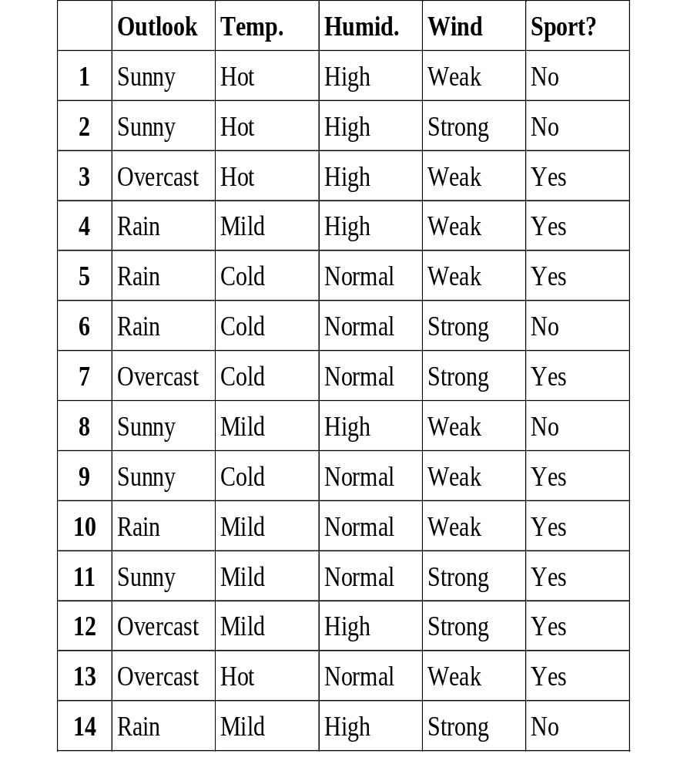
My Favorite Example
If P means “it’s sunny”, then P is true in worlds 1,2,9,11
If Q means “it’s very humid”, then Q is true in worlds 1-4,8,12,14
If S means “I’m practicing sport”, then S is true in worlds 3-5,7,9-13

Slide 12
Another Example…
Sun
(%)
Temp.
(°C)
Humid.
(%)
Wind
(km/h)
Run
(km/h)
To what extent P, which means that “it’s sunny”, is true in particular cases?
1
100
31
90
10
6
2
90
22
85
50
8
3
50
25
95
20
12
4
0
15
80
0
13
5
10
4
70
10
15
6
30
7
55
40
7
7
40
8
65
60
15
1
8
70
14
90
20
10
9
80
1
70
30
14
„sunny”
10
20
13
60
0
14
0
11
80
11
60
70
14
25%
100%
12
60
17
80
50
13
13
50
26
55
30
16
14
20
12
95
60
9

Slide 13
INTERPRETATION
Formally, an interpretation is a mapping from the propositional symbols into the set {T,F}
The symbol true is always assigned T, and the symbol false is assigned F

Slide 14
INTERPRETATION
Negation ¬P is assigned T, if and only if P is assigned F
Conjunction P ∧ Q is assigned T, if and only if P and Q are assigned T
Disjunction P ∨ Q is assigned T, if and only if P or Q are assigned T

Slide 15
IMPLICATION
Implication P → Q is assigned T unless the premise P is assigned T and its consequence Q is assigned F
P | Q | P → Q
T | T | T
T | F | F
F | T | T
F | F | T

Slide 16
My Favorite Example Again…
Sentence of the form: P ∧ Q → ¬S means that:
“If it’s sunny and very humid, then I don’t practice sport”
This sentence is true for the whole table (So perhaps it’s true in general? – This is machine learning…)

Slide 17
EQUIVALENCE
Equivalence ≡ of two expressions is assigned T (true), if and only if they have the same truth assignment
Some helpful tautologies (sentences, which are always true, whatever the variable truth assignments are):
( P → Q ) ≡ (¬ Q → ¬ P )
¬ ( P ∨ Q ) ≡ ¬ P ∧ ¬ Q
( P ∨ Q ) ∨ S ≡ P ∨ ( Q ∨ S )
P ∧ ( Q ∨ S ) ≡ ( P ∧ Q ) ∨ ( P ∧ S )

Slide 18
INTRODUCTION TO SATISFIABILITY PROBLEMS

Slide 19
Decision Problem Specification
INPUT: A propositional sentence
QUESTION: Is the sentence satisfiable (i.e.: is there a world in which this sentence is satisfied?)
IN OTHER WORDS: Is there such truth assignment of all propositional symbols occurring in the sentence, which make it to be assigned T?
OUTPUT: YES or NO

Slide 20
Example
Is the following formula satisfiable?
[ ( P ∧ S ) ∨ ¬ Q ] → [ ( Q ∨ P ) ∧ ¬ S ]
YES. It is enough to set up P and S as F (false), and Q as T (true)
Indeed, then the truth assignment for the whole formula is T (true)

Slide 21
(Open) Question
What is complexity of the procedure checking whether each given particular sentence is satisfiable?
Well, one could check all combinations of true/false assignments of the symbols occurring in a given sentence…
But it provides us with an exponential time complexity depending on the number of propositional variables involved in the sentence structure…

Slide 22
Conjunctive Normal Form (CNF)
A propositional formula is in the CNF-form, if and only if it is the conjunction of disjunctions of propositional symbols or their negations
For instance:
( P ∨ Q ) ∧ (¬ P ∨ Q ∨ ¬ S )
Disjunctions are then called clauses, and the propositional symbols and their negations are called literals

Slide 23
Representation
Any propositional formula can be equivalently presented in the CNF-form
For instance
[ ( P ∧ S ) ∨ ¬ Q ] → [ ( Q ∨ P ) ∧ ¬ S ]
is equivalent to
( P ∨ Q ) ∧ (¬ P ∨ ¬ S ) ∧ ( Q ∨ ¬ S )

Slide 24
Decision Problem SAT
INPUT: A sentence in the CNF-form
OUTPUT:
  YES, if it is satisfiable
  or NO otherwise
SAT is NP-complete (it means that its solution in polynomial time would enable solving any decision problem from NP-class in polynomial time)

Slide 25
GOAL AND DATA DRIVEN SEARCH

Slide 26
DATA-DIRECTED SEARCH
In data-directed search (forward chaining), the problem solver begins with the given facts of the problem and a set of legal moves or rules for changing state
Search proceeds by applying rules to facts to produce new facts, which are in turn used by the rules to generate more new facts
This process continues until (we hope!) it generates a path that satisfies the goal condition

Slide 27
GOAL-DIRECTED SEARCH
In goal-directed search (backward chaining), we begin with the goal we want to solve, check what rules or legal moves could be used to generate this goal, and determine what conditions must be true to use them
Search continues working backward through successive subgoals until (we hope!) it works back to the facts of the problem
This finds the chain of moves or rules leading from data to a goal, although it does so in backward order

Slide 28
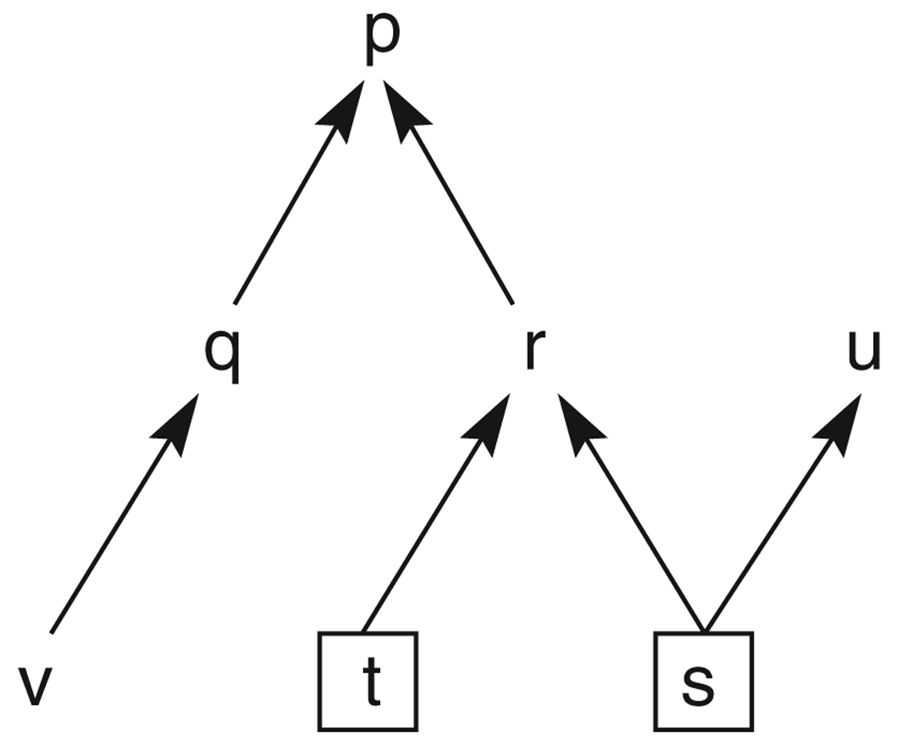
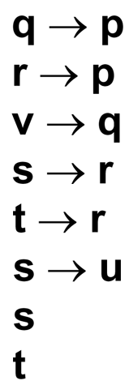
Example: State space graph of a set of implications

Slide 29
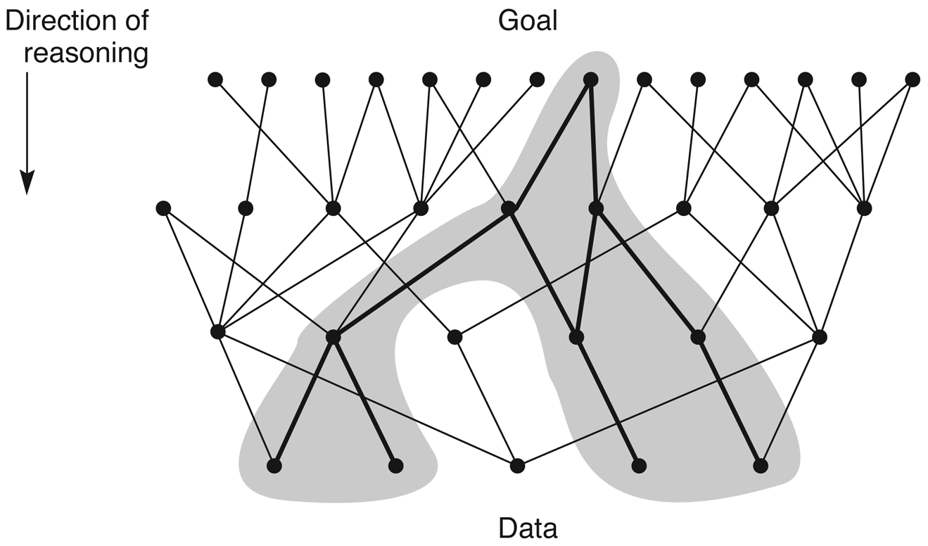
GOAL-DIRECTED SEARCH
State space in which goal-directed search effectively prunes extraneous search paths

Slide 30
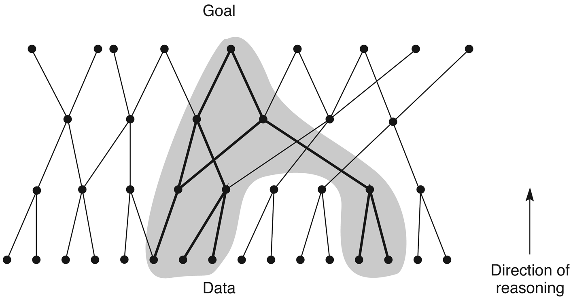
DATA-DIRECTED SEARCH
State space in which data-directed search prunes irrelevant data and their consequents and determines one of a number of possible goals

Slide 31
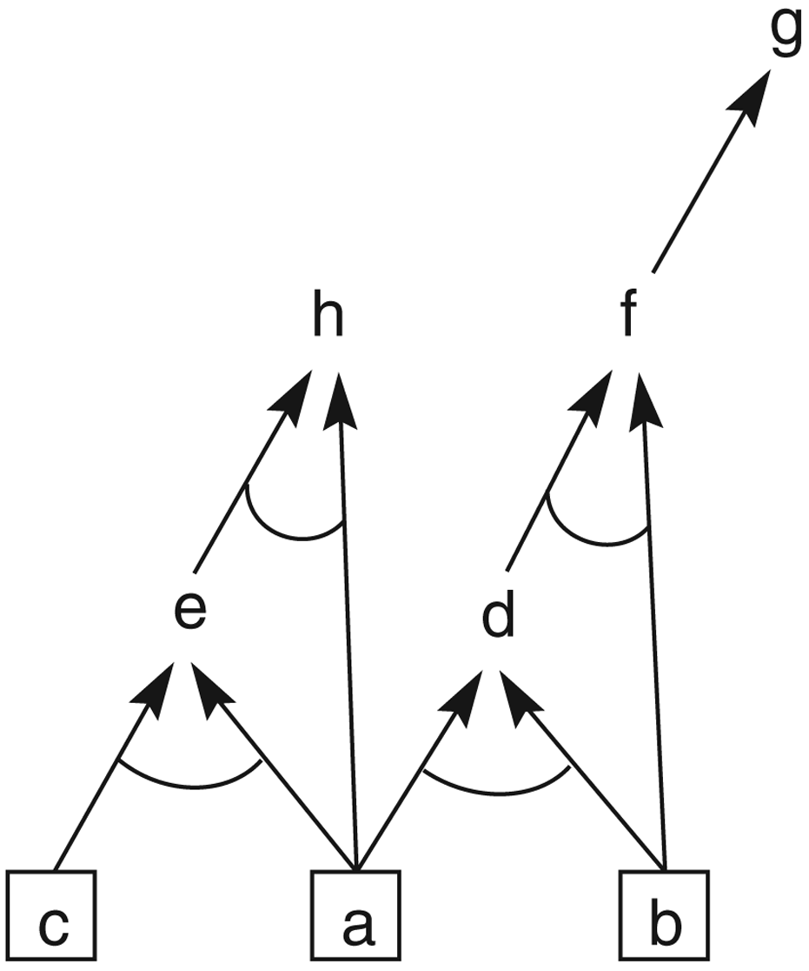
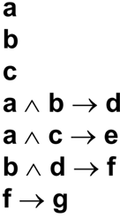
AND/OR GRAPHS

Slide 32
AUTOMATED REASONING

Slide 33
Introduction
Automated reasoning program employs an unambiguous and exacting notation for representing information, precise inference rules for drawing conclusions, and carefully delineated strategies to control those inference rules

Slide 34
Introduction
A good choice for representation includes a notation that increases the chance for solving a problem and includes information that, though not necessary, is helpful
A good choice of inference rules is one that meshes well with the chosen representation
A good choice for strategies is one that controls inference rules in a manner that sharply increases the effectiveness of the program

Slide 35
GENERAL PROBLEM SOLVER

Slide 36
Logic Theorist (1963)
Representation:
  Propositional calculus
Inference rules:
  Substitution
  Replacement
  Detachment
Strategies:
  Heuristic methods to guide reasoning

Slide 37
Substitution
It allows any expression to be substituted for every occurrence of a symbol in a proposition that is an axiom or theorem already known to be true
For instance, (B∨B)→B may have the expression ¬A substituted for B to produce (¬A∨¬A)→¬A

Slide 38
Replacement
It allows a connective to be replaced by its definition or an equivalent form
For example, the logical equivalence of ¬A∨B and A→B can lead to the replacement of (¬A∨¬A) with (A→¬A)

Slide 39
Detachment
This is the inference rule we called modus ponens

Slide 40
Matching Process
Suppose we wish to prove
p→(q→p)
We have a lot of axioms to start with
One of them is p→(q∨p)
It seems to be appropriate because the main connective (→) is the same…

Slide 41
Another Example
Suppose we wish to prove
(p→ ¬p)→ ¬p
Matching identifies “best axiom”
(A∨A)→A
Then we can continue:
(¬A∨¬A)→ ¬A (substitution)
(A→ ¬A)→ ¬A (replacement)
(p→ ¬p)→ ¬p (substitution)
QED

Slide 42
Strategy – Executive Routine
The substitution method is directly applied to the current goal, attempting to match it against all known axioms and theorems
If this fails to lead to a proof, all possible detachments and replacements are applied to the goal and each of these results is tested for success using substitution; If it fails to match any of these with the goal, they are added to a subproblem list

Slide 43
Strategy – Executive Routine
The chaining method, employing the transitivity of implication, is used to find a new subproblem that, if solved, would provide the proof (If a→c is the problem and b→c is found, then a→b is set up as a new subproblem)
If the first three methods fail on the original problem, go to the subproblem list and select the next untried subproblem

Slide 44
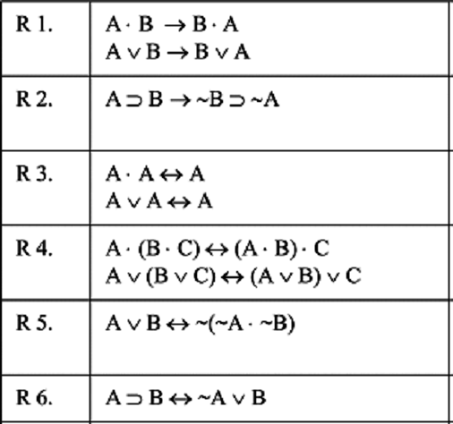
Transformation rules for logic problems (Newell & Simon, 1961)
“⋅” denotes conjunction
“∨” denotes disjunction
“∼” denotes negation
“⊃” denotes implication
“→” and “↔” denote legal replacement

Slide 45
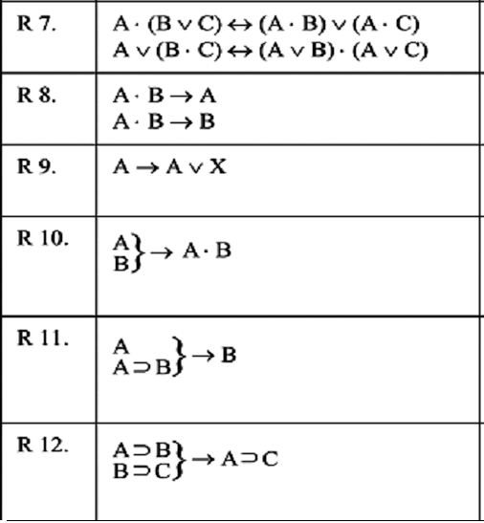
Transformation rules for logic problems (Newell & Simon, 1961)
Modus Ponens (Detachment)
Chaining

Slide 46
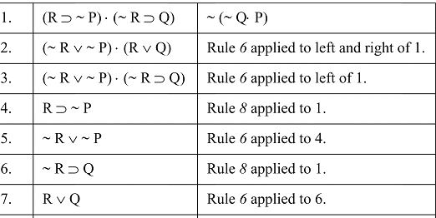
A proof of a theorem in propositional calculus (Newell & Simon, 1961)

Slide 47
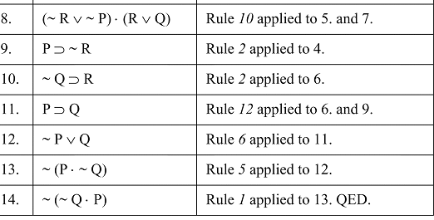
A proof of a theorem in propositional calculus (Newell & Simon, 1961)

Slide 48
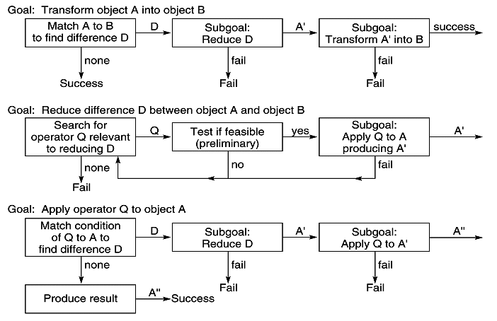
Flow charts for General Problem Solver (Newell & Simon, 1963)

Slide 49
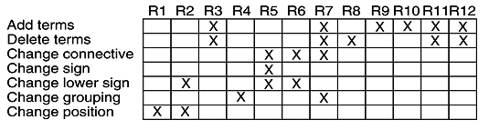
Table of connections for GPS (Newell & Simon, 1963)
X means some variant of the rule is relevant
GPS will pick the appropriate variant

Slide 50
PREDICATE CALCULUS

Slide 51
Symbols
Alphabet:
  The set of letters of the English alphabet
  The set of digits, 0, 1, …, 9
  The underscore, _
Symbols in the predicate calculus begin with a letter and are followed by any sequence of these legal characters

Slide 52
Types of Symbols
Truth symbols true and false (reserved)
Constant symbols are symbol expressions having the first character lowercase
Variable symbols are symbol expressions beginning with an uppercase character
Function symbols are symbol expressions having the first character lowercase

Slide 53
Predicates
Predicate symbols are symbols beginning with a lowercase letter
Predicates have an associated positive integer referred to as the arity or “argument number” for the predicate
Predicates with the same name but different arities are considered distinct

Slide 54
Atomic Sentences
The truth values, true and false
Predicate constants of arity n, followed by n terms, t₁,t₂,…,t_{n}, enclosed in parenthesis, separated by commas

Slide 55
Terms
Constants
Variables
Function expressions

Slide 56
Functions
Functions have an attached arity indicating the number of elements of the domain mapped onto each element of the range
A function expression consists of a function constant of arity n, followed by n terms, t₁,t₂,…,t_{n}, enclosed in parenthesis, separated by commas

Slide 57
Predicate Sentences
We start with the atomic sentences
Negation of a sentence is a sentence; conjunction, disjunction, implication, equivalence between two sentences is a sentence (like in prop. calculus)
If X is a variable and s is a sentence, then ∀ X s and ∃ X s are sentences

Slide 58
Interpretation
Let the domain D be a nonempty set
Interpretation over D is an assignment of the entities of D to each of the constant, variable, predicate and function symbols of a predicate calculus expression, such that:….

Slide 59
Such that….
Each constant is assigned an element of D
Each variable is assigned a nonempty subset of D; these are the allowable substitutions for that variable

Slide 60
Such that….
Each function f of arity m is defined on m arguments of D and defines a mapping from D^{m} into D
Each predicate p of arity n is defined on n arguments of D and defines a mapping from D^{n} into {T,F}

Slide 61
KNOWLEDGE BASES

Slide 62
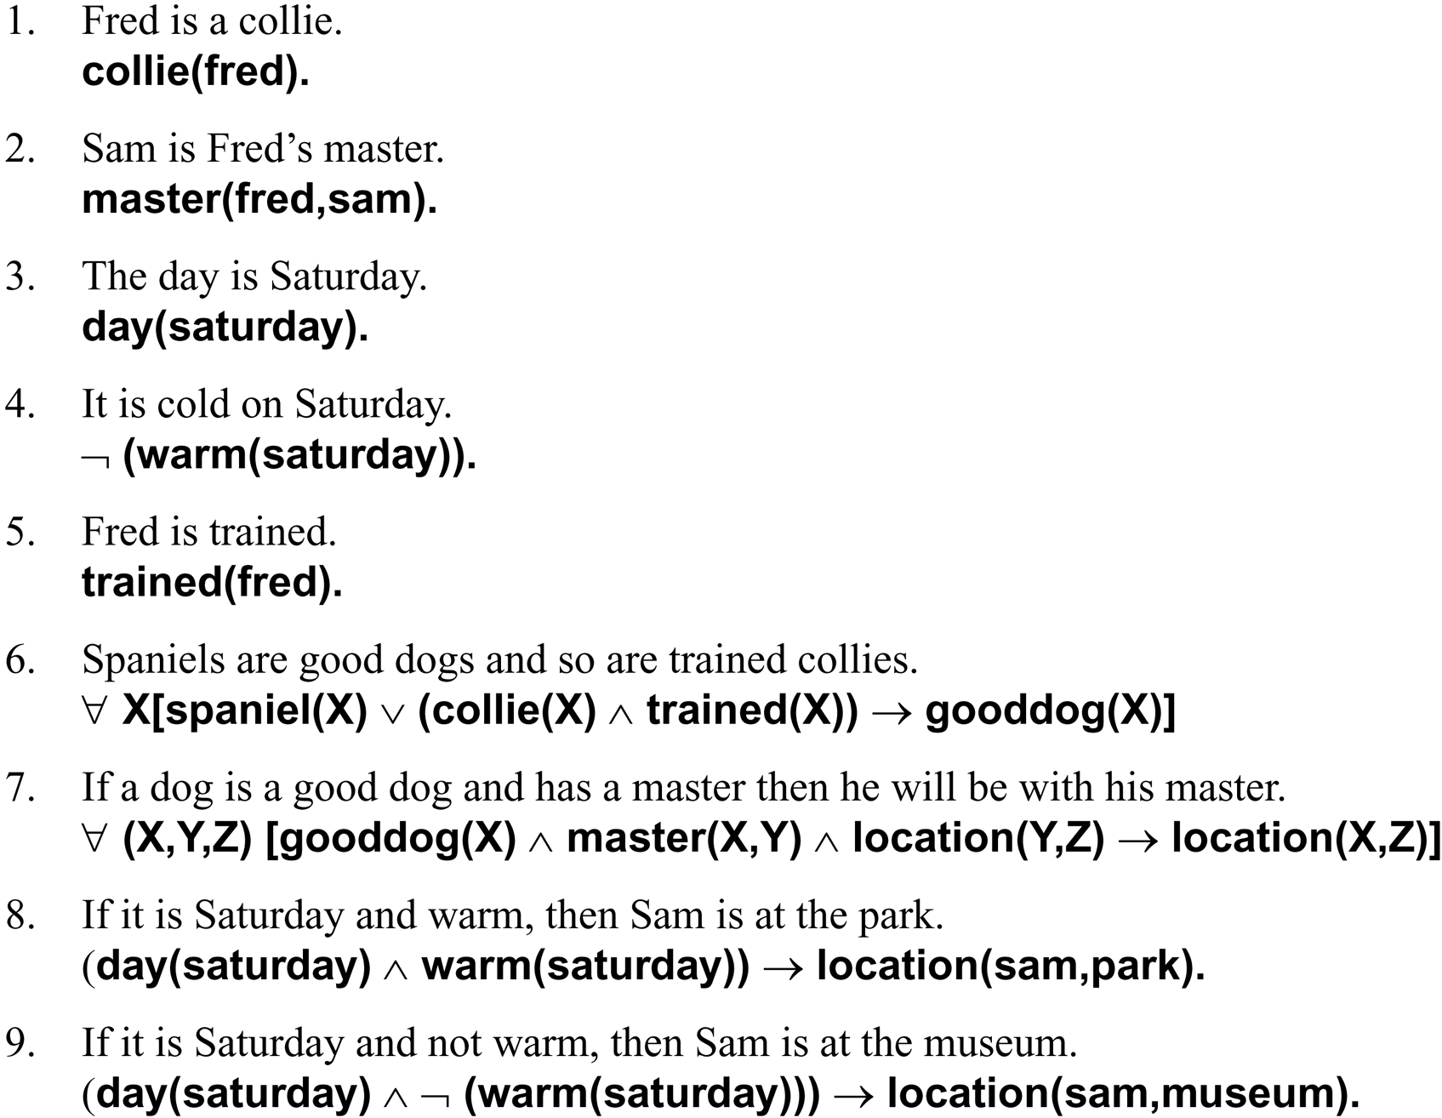
EXAMPLE OF A KNOWLEDGE BASE

Slide 63
Inference Rules in Predicate Calculus
Modus ponens: If the sentences P and P→Q are known to be true, we can infer Q
Modus tollens: If P→Q is known to be true and Q is known to be false, we can infer ¬P
And elimination: P∧Q lets us conclude P and Q are true
And introduction: P and Q let us conclude P∧Q is true
Universal instantiation: If a is from the domain of X, the sentence ∀ X p(X) lets us infer p(a)

Slide 64
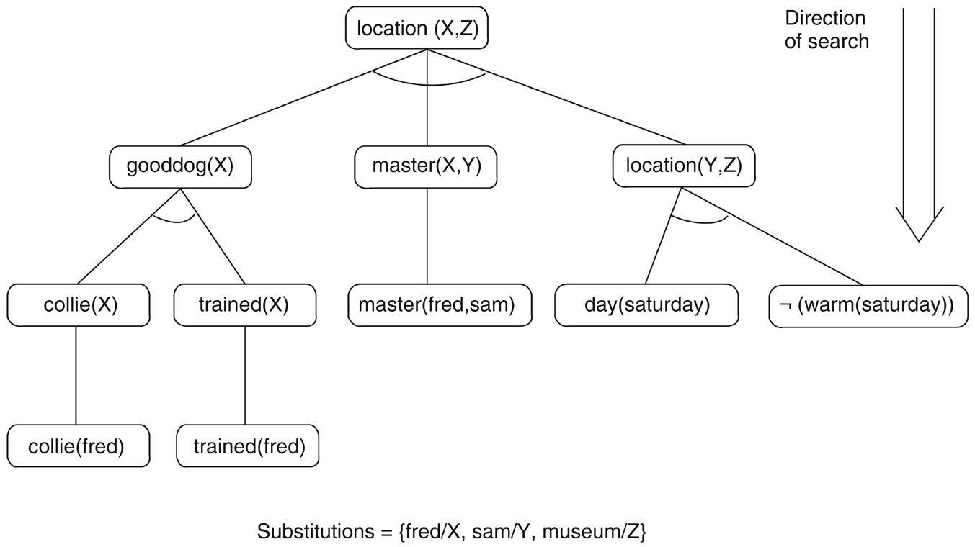

Slide 65
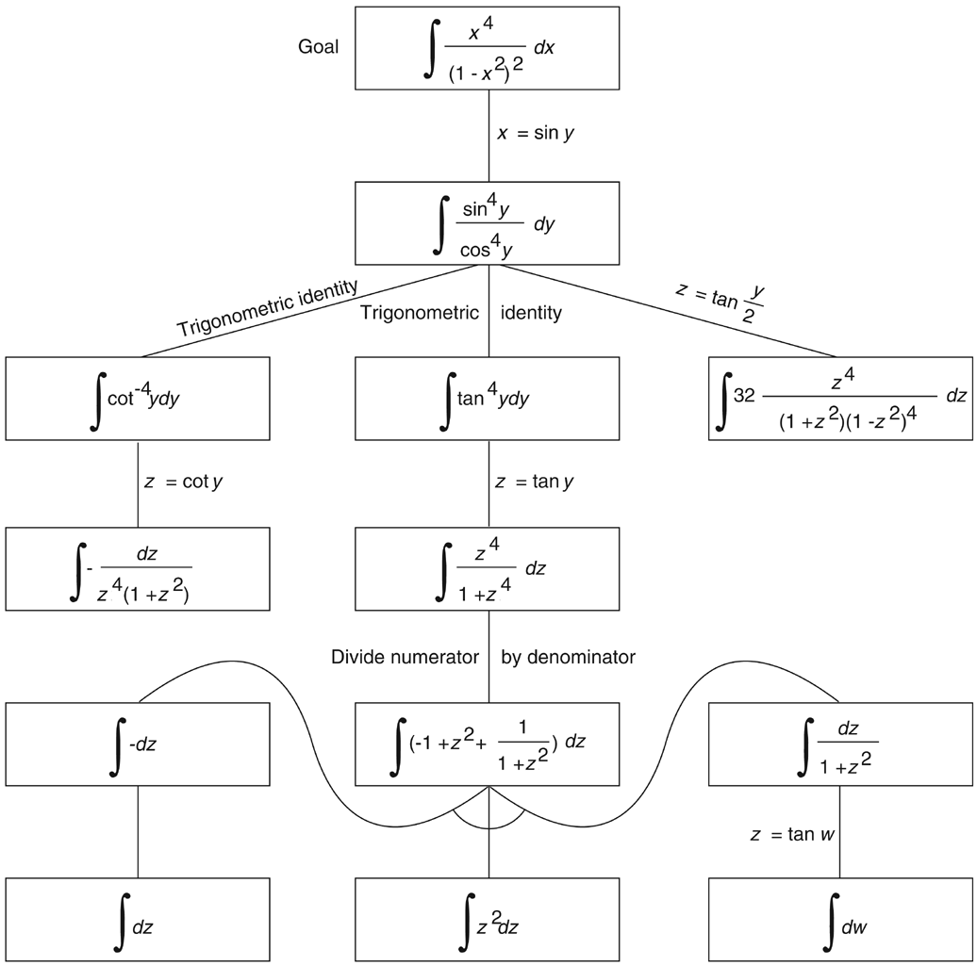
Goal-directed search…
…is a good example of recursion

Slide 66
RESOLUTION THEOREM PROVING

Slide 67
Resolution refutation proof
Put the premises or axioms into clause form (CNF-form)
Add the negation of what is to be proved, in clause form, to the set axioms
Resolve these clauses together, producing new clauses that logically follow from them
Produce a contradiction by generating the empty clause

Slide 68
Example
We wish to prove that
“Fido will die”
from the statements that
“Fido is a dog”
and
“all dogs are animals”
and
“all animals will die”

Slide 69
Applying modus ponens to the corresponding predicates
All dogs are animals:
∀(X)(dog(X)→animal(X))
Fido is a dog:
dog(fido)
Modus ponens and {fido/X} gives:
animal(fido)
All animals will die:
∀(Y)(animal(Y)→die(Y))
Modus ponens and {fido/Y} gives:
die(fido)

Slide 70
Reasoning by resolution
∀(X)(dog(X)→animal(X)) | ¬dog(X)∨animal(X)
dog(fido) | dog(fido)
∀(Y)(animal(Y)→die(Y)) | ¬animal(Y)∨die(Y)
¬die(fido) | ¬die(fido)
We show that the following is false:
(¬dog(X)∨animal(X))∧(dog(fido))∧ (¬animal(Y)∨die(Y))∧(¬die(fido))

Slide 71
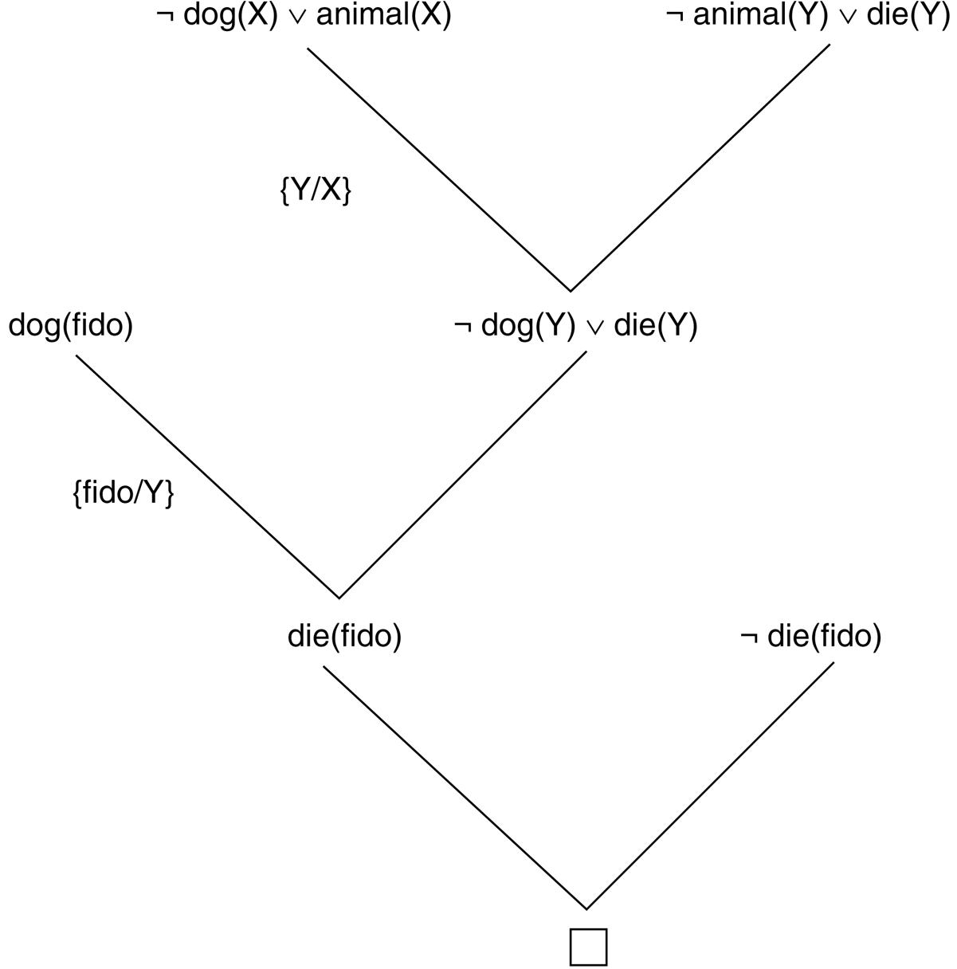
Resolution proof

Slide 72
Summary
The resolution refutation proof procedure answers a query or deduces a new result by reducing the set of clauses to a contradiction, represented by the null clause ()
The contradiction is produced by resolving pairs of clauses from the database
If a resolution does not produce a contradiction directly, then the clause produced by the resolution, the resolvent, is added to the database of clauses and the process continues

Slide 73
Binary Resolution Procedure
Suppose
a∨¬b and b∨c
are both true statements
One of literals b and ¬b must be false
Therefore, one of literals a and c is true
As a conclusion, a∨c is true
a∨c is the resolvent of the parent clauses a∨¬b and b∨c

Slide 74
Example
Suppose we have axioms
a←b∧c
b
c←d∧e
e∨f
d∧¬f
We want to prove a

Slide 75
Reducing to the clause form
a←b∧c
a∨¬(b∧c) by l→m ≡ ¬l∨m
a∨¬b∨¬c by de Morgan’s law

Slide 76
Final clause form
a←b∧c | a∨¬b∨¬c
b | b
c←d∧e | c∨¬d∨¬e
e∨f | e∨f
d∧¬f | d
 | ¬f

Slide 77
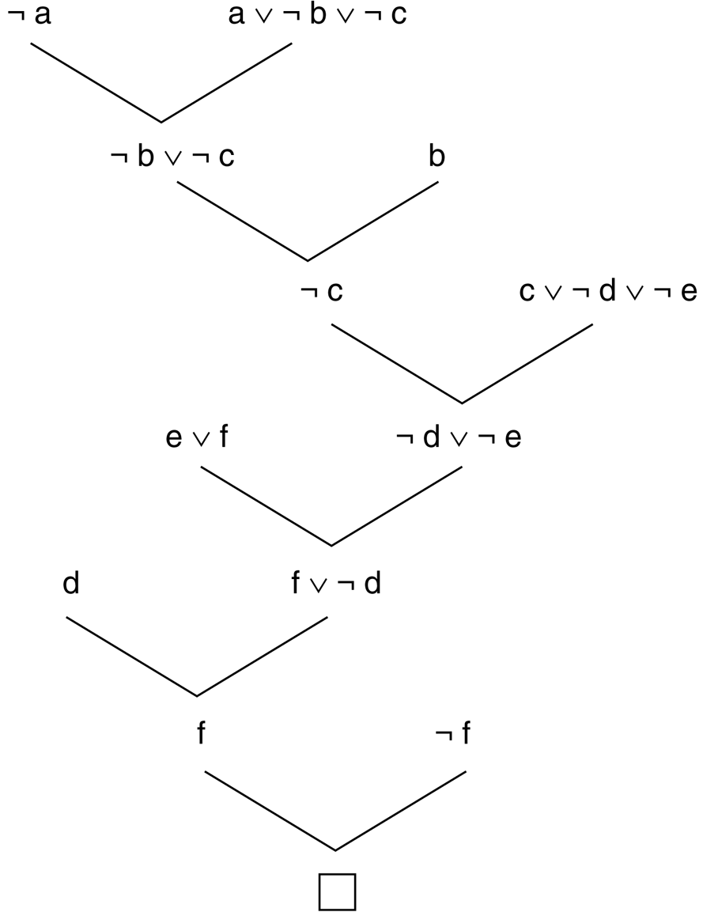
Resolution proof

Slide 78
Yet another example…
Anyone passing his history exams and winning the lottery is happy. But anyone who studies or is lucky can pass all his exams. John did not study but he is lucky. Anyone who is lucky wins the lottery. Is John happy?

Slide 79
Predicate Calculus
Anyone passing his history exams and winning the lottery is happy
∀X(pass(X,history)∧win(X,lottery)→happy(X))
Anyone who studies or is lucky can pass all his exams
∀X∀Y(study(X)∨lucky(X)→pass(X,Y))
John did not study but he is lucky
¬study(john)∧lucky(john)
Anyone who is lucky wins the lottery
∀X(lucky(X)→win(X,lottery))

Slide 80
Clause form
Premises:
¬pass(X,history)∨¬win(X,lottery)∨happy(X)
¬study(Y)∨pass(Y,Z)
¬lucky(W)∨pass(W,V)
¬study(john)
lucky(john)
¬lucky(U)∨win(U,lottery)
Negation of conclusion:
¬happy(john)

Slide 81
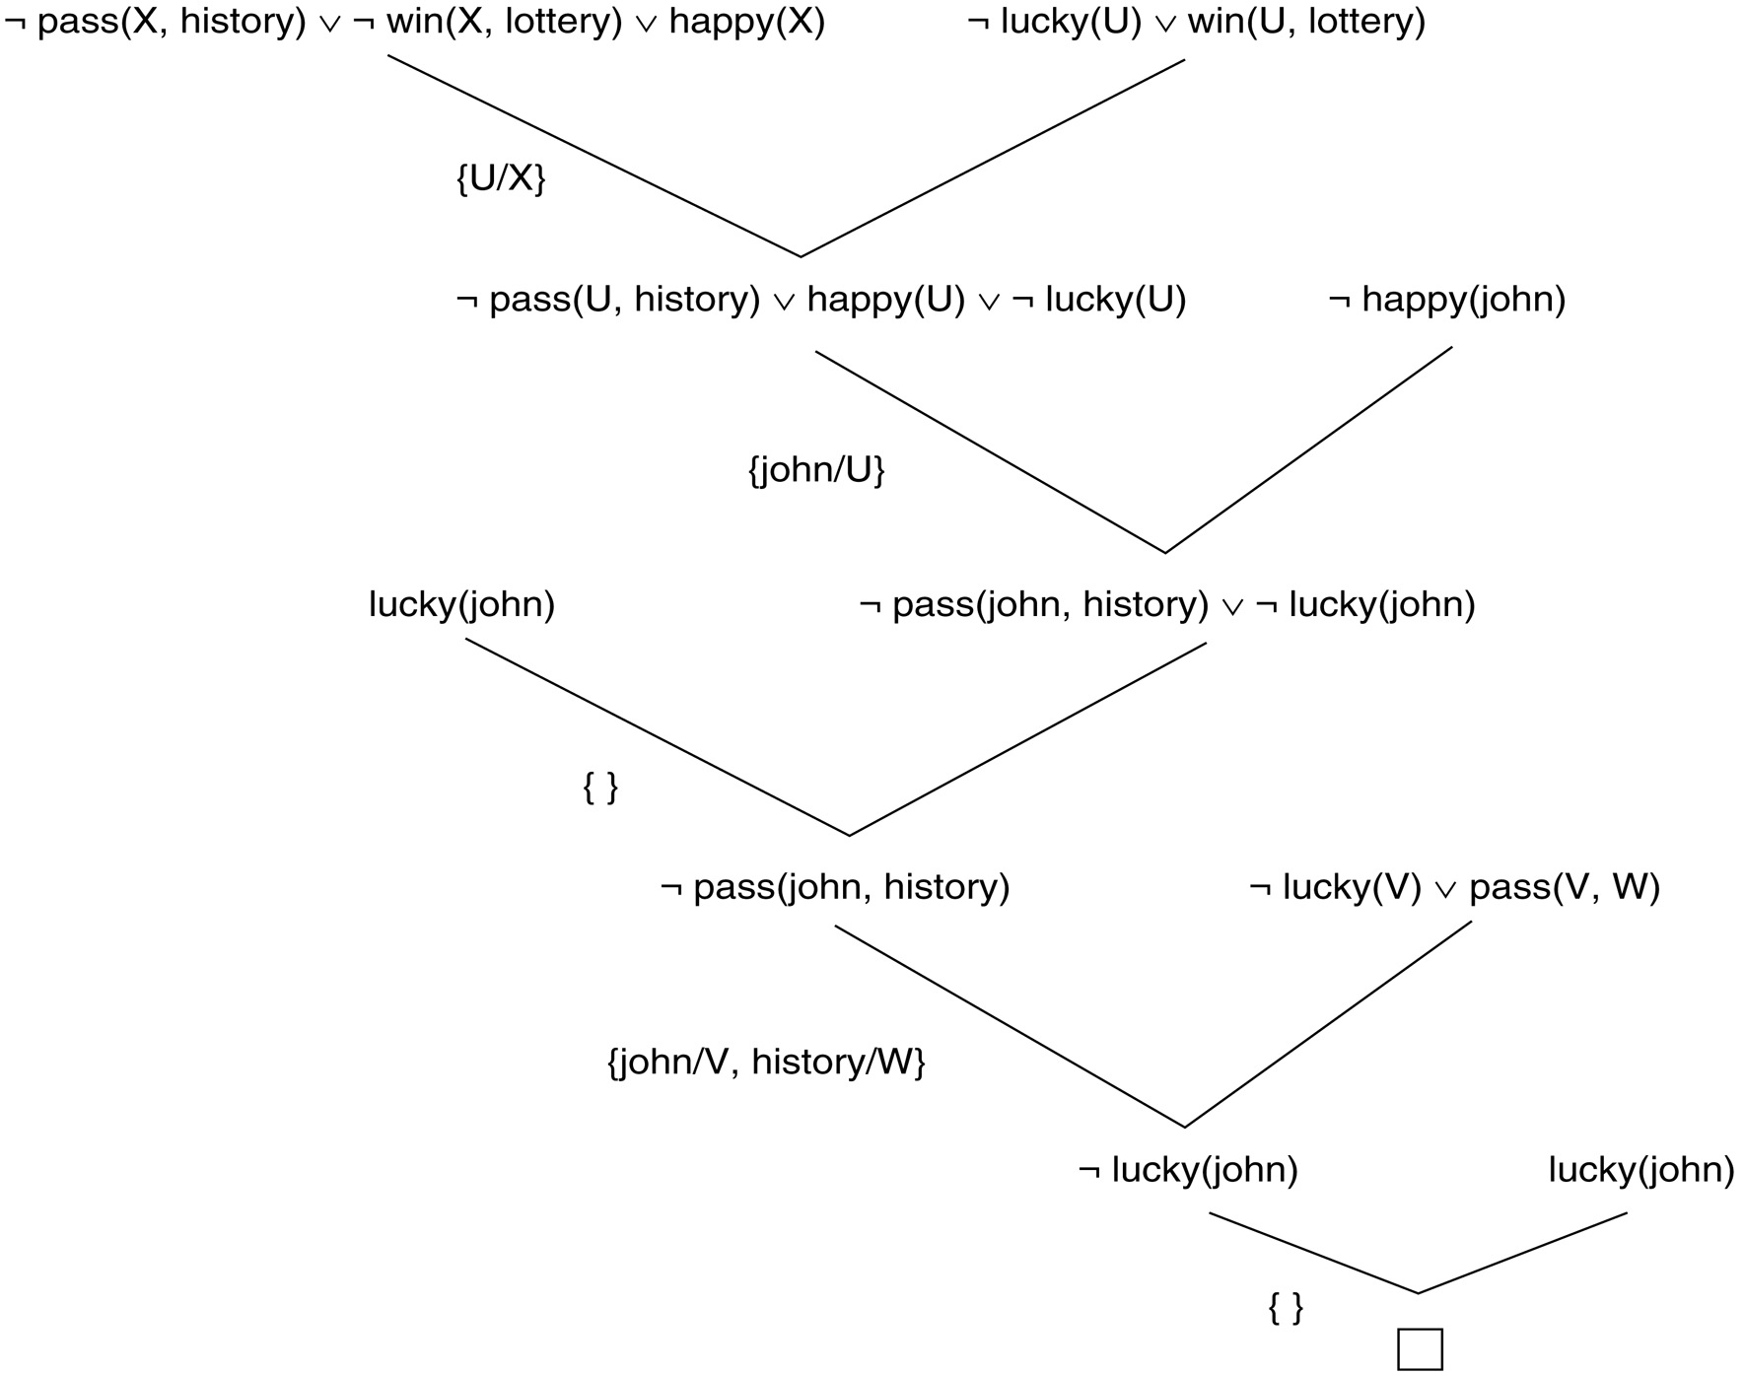
Resolution proof

